Slide 1
Employee Data Analysis using Excel
STUDENT NAME: S.Pragathi
REGISTER NO:914485&312211189
DEPARTMENT:B.COM BANK MANAGEMENT
COLLEGE :MGR janaki womens college

Slide 2
PROJECT TITLE
Employee Performance Analysis using Excel

Slide 3


AGENDA
Problem Statement
Project Overview
End Users
Our Solution and Proposition
Dataset Description
Modelling Approach
Results and Discussion
Conclusion
3/21/2024 Annual Review

Slide 4

PROBLEM STATEMENT
The employee data analysis done in order track the employee's performance for the betterment of the company

Slide 5

PROJECT OVERVIEW
.
Analysing the performance of the employee by considering various factors like Gender, performance score,ratings achivement ect, called employee data analysis

Slide 6

WHO ARE THE END USERS?
★CEO
★MANAGER
★ASSISTANT MANAGER
★REQULAR EMPLOYEE

Slide 7

OUR SOLUTION AND ITS VALUE PROPOSITION
Conditional formatting _missing
Filter _remove
Formula_ performance
Graph _data visualization

Slide 8
Dataset Description
Employee=kaggle
26_ features
9_Features
Empid_num
Name_text
Emp type
Performance level
Gender _male female
Employee rating _num

Slide 9

THE "WOW" IN OUR SOLUTION
Performance level= IFS(Z8>=5"VERY HIGH"ZB>=4
"HIGH" ,Z8>=3"MED" ,TRUE "LOW"
3/21/2024 Annual Review
9

Slide 10
MODELLING
Data collection
1)From kaggle
2)From edunet dash board
Feature collection
Data cleaning
1) Identified missing value
2) filtered out the missing value
Performance level calculation
1) through attendance
2) Ratings
Pivot table
Graph
1) visualization
10

Slide 11
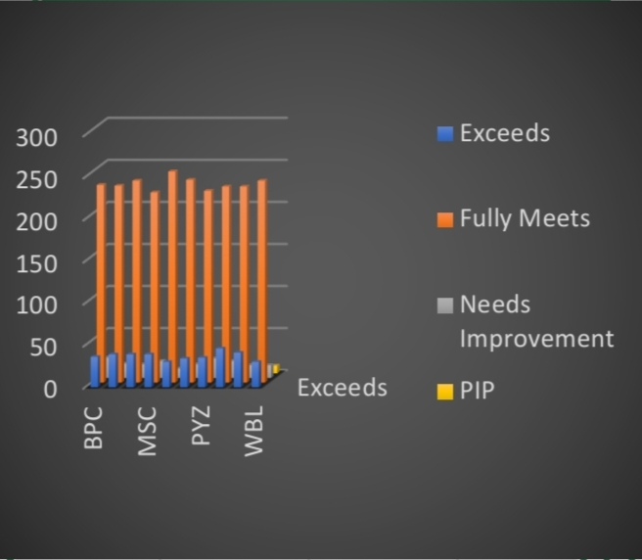
RESULTS
11

Slide 12
conclusion
For my English project I read the book The Giver by Lois Lowry. It is about a boy named Jonas who lives in a society without feelings. Jonas is selected to be the Receiver of Memories. He learns the truth about his society. The Giver shows how important feelings and memories are. I enjoyed reading this book and thinking about the message.

